Slide 1
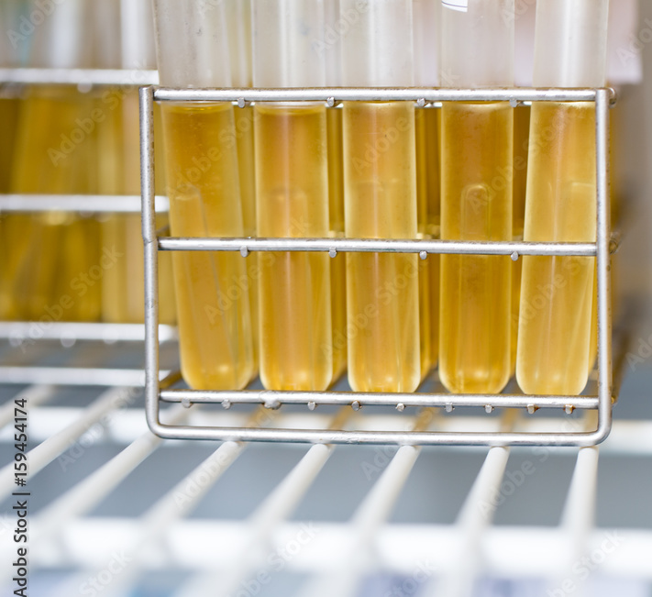
You will need
Flow chart
Test results table
Identifying a single unknown bacteria from broth

Slide 2
General notes: steps for ID
Bacilli are all rod shaped (like a pill)
Cocci are all circle shaped
Gram positive organism are always purple on Gram staining
Gram negative organisms are always pink on Gram staining
All students will have the table and their own flow chart to use
Students always Gram stain first
  Then they grow on TSA as a confirmation for Gram stain
Second level is selective media:
  MacConkey for Gram negatives
  Mannitol salt agar (MSA) for Gram positives
Third level is biochemical test
  for Gram negative: Citrate, MR .. see table
  for Gram positive: Blood agar, catalase.. see table

Slide 3
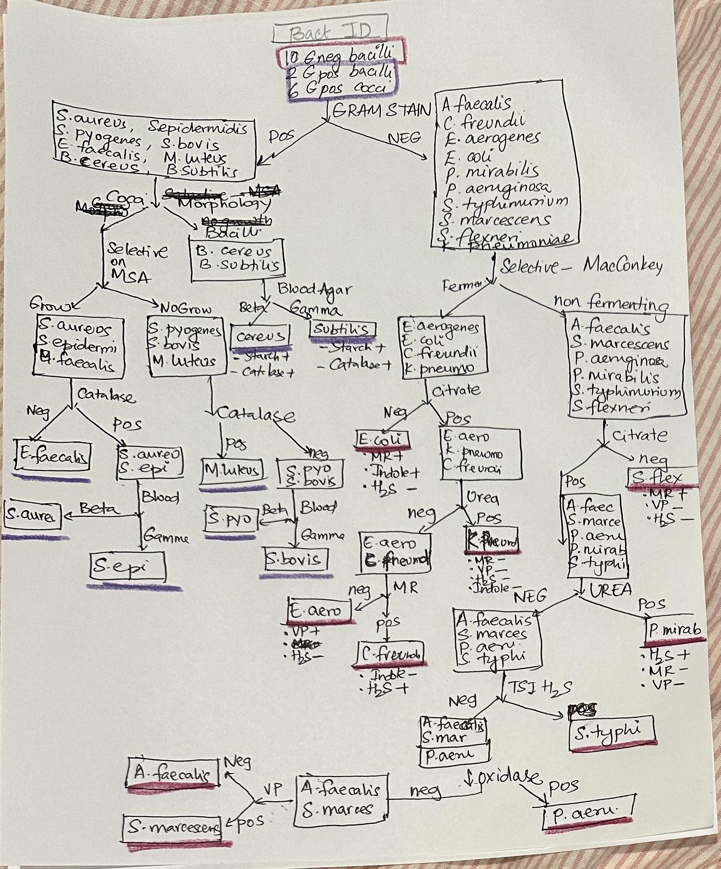
One possible flow chart

Slide 4
Data table for all bacteria
Link to the table in the same folder

Slide 5
Example identifying E.coli
Gram staining: Gram negative bacilli
Level 1 test
Selective media: Grow and ferment on MacConkey
Level 2 test
Identify in this order of test
Citrate negative
MR positive
Indole positive
Level 3 test:
Students can choose any of these in any order

Slide 6
Here is how student would see the UI

Slide 7
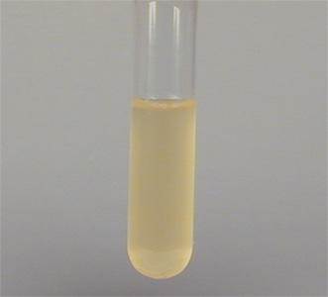
Here is your sample
Gram stain
Streak TSA

Slide 8
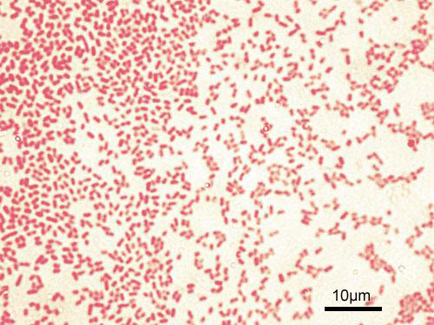
First page test: Gram stain result
Go back
Selective media

Slide 9
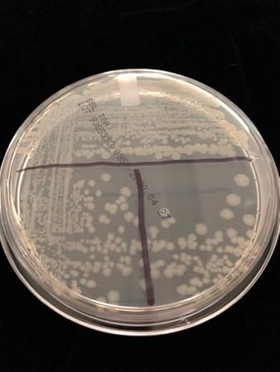
First page test result: TSA result
Go back
Selective media

Slide 10
Second level selective media:
Choose one to find the result
MacConkey Agar
Mannitol Salt Agar
** if they choose Mannitol salt agar (MSA) it would say incorrect choice. It would move further only if they choose MacConkey Agar

Slide 11
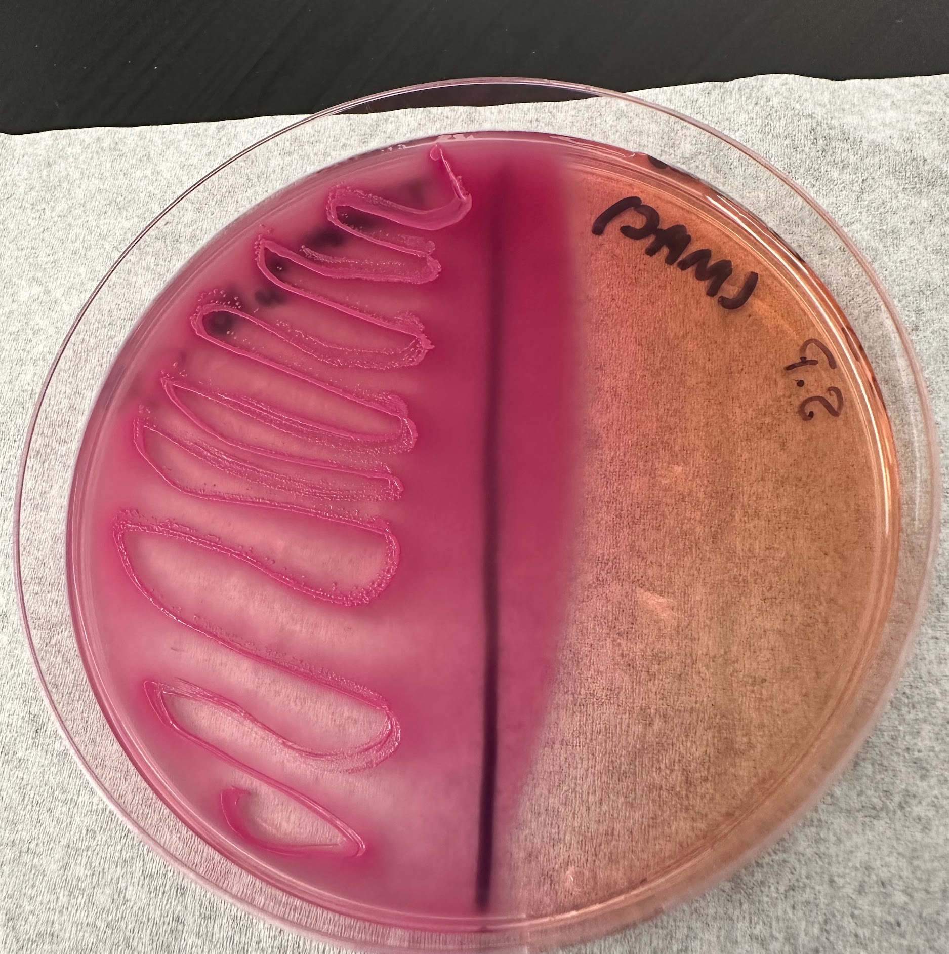
Second level result: MacConkey Agar result
Go back
Further test
ID the organism

Slide 12
3rd level Further tests: Biochemical tests
Citrate test
TSI H2S
Urea test
TSI Ferment
VP test
MR test

Slide 13
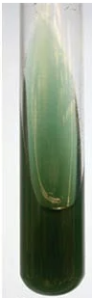
Citrate test
ID the organism

Slide 14
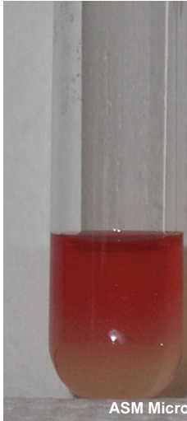
MR test
ID the organism

Slide 15
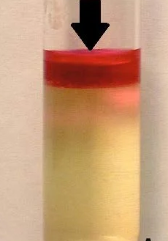
Indole test
ID the organism

Slide 16
ID the organism: Would list them all
Gram negatives are the only ones listed in this page since the Slide 5 was the pink organisms
** Gram positive organisms (lower level of the table) would be only listed if Slide 5 was the purple colored gram stain

